Slide 1
Mastering NT Greek
22. Enticing Infinitives
By Ted Hildebrandt © 2003
Baker Academic

Slide 2
Warm-ups

Slide 3
Rapping the Lord’s Prayer
Πάτερ ἡμῶν ὁ ἐν τοῖς οὐρανοῖς father our the one in heaven
ἁγιασθήτω τὸ ὄνομά σου make holy name your
ἐλθέτω ἡ βασιλεία σου let come kingdom your
γενηθήτω τὸ θέλημά σου, let be will your

Slide 4
Rapping the Lord’s Prayer
ὡς ἐν οὐρανῷ καὶ ἐπὶ γῆς· as in heaven also on earth
τὸν ἄρτον ἥμῶν τὸν the bread our
ἐπιούσιον δὸς ἡμῖν σήμερον· daily give us today

Slide 5
Rapping the Lord’s Prayer
καὶ ἄφες ἡμῖν τὰ ὀφειλήματα ἡμῶν and forgive us trespasses our
ὡς καὶ ἡμεῖς ἀφήκαμεν as also we have forgiven
τοῖς ὀφειλέταις ἡμῶν the ones trespassing us

Slide 6
Rapping the Lord’s Prayer
καὶ μὴ εἰσενέγκῃς ἡμᾶς and do not lead us εἰς πειρασμόν into temptation ἀλλὰ ῥῦσαι ἡμᾶς ἀπὸ but deliver us from τοῦ πονηροῦ the evil one

Slide 7
2-1-2 Paradigms - Chant this
2 1 2
λόγος γραφή ἱερόν
λόγου γραφῆς ἱεροῦ
λόγῳ γραφῇ ἱερῷ
λόγον γραφήν ἱερόν
λόγοι γραφαί ἱερά
λόγων γραφῶν ἱερῶν
λόγοις γραφαῖς ἱεροῖς
λόγους γραφάς ἱερά

Slide 8
3rd Declension Chantables
χαρίς ὄνομα, πίστις
χάρις ὄνομα πίστις
χάριτος ὀνόματος πίστεως
χάριτι ὀνόματι πίστει
χάριτα ὄνομα πίστιν
χάριτες ὀνόματα πίστεις
χαρίτων ὀνομάτων πίστεων
χάρισι(ν) ὀνόμασι(ν) πίστεσι(ν)
χάριτας ὀνόματα πίστεις

Slide 9
PAI Verb Chant
λύω λύομεν
λύεις λύετε
λύει λύουσι(ν)

Slide 10
The "is" verb PAI -- εἰμί
εἰμί ἐσμέν εἶ ἐστέ ἐστί(ν) εἰσί(ν)

Slide 11
Imperfect εἰμί
ἤμην ἦμεν ἦς ἦτε ἦν ἦσαν

Slide 12
Person Personal Pronoun Chant
Singular Plural
Nom. ἐγώ σύ ἡμεῖς
Gen. μου σου ἡμῶν Dat. μοι σοι ἡμῖν Acc. με σε ἡμάς
αὐτός, αὐτη, αὐτό (he, she, it)

Slide 13
Present Middle/Passive Indicative
λύομαι, -ομεθα -ῃ, -εσθε -εται, -ονται
I am loosed/am being loosed
I loose myself/am loosing [for myself]

Slide 14
Shape of the Future in Greek
λύσω λύσομεν I will loose We will loose
λύσεις λύσετε You will loose You all will loose
λύσει λύσουσι(ν) S/he/it will loose They will loose
Chant this one

Slide 15
Future Middle Paradigm
λύσομαι -όμεθα -ῃ -εσθε -εται -ονται
I will loose (for myself) We will loose (for ourselves) …

Slide 16
Demonstrative and Relative Pronouns Summary
ἐκεῖνος, ἐκείνη, ἐκεῖνο = that
οὗτος, αὕτη, τοῦτο τούτου, ταύτης, τούτου = this
ὅς ἥ ὅ = Relative (who, which) οὗ ἧς οὗ

Slide 17
Imperfect Active Paradigm of λύω
Chant: ἐλυον, ν, ς, ε, μεν, τε, ν I was loosing, …

Slide 18
Imperfect Middle/Passive (IM/PI)
Chant: ἐλυόμην ου, ετο, ομεθα, εσθε, οντο
I was being loosed

Slide 19
Second Aorist Active Chant
ἔλαβον ν, σ, ε, μεν, τε, ν

Slide 20
Second Aorist Middle Chant
ἐγενόμην -ου, -ετο, -ομεθα, -εσθε, -οντο

Slide 21
Aorist Stem Changes -- 8 to know
ἔρχομαι == ἦλθον (I came, went)
βλέπω == εἶδον (I saw)
λέγω == εἶπον (I said)
γίνομαι == ἐγενόμην (I became)
γινώσκω == ἔγνων (I knew)
ἔχω == ἔσχον ( I had)
λαμβάνω == ἔλαβον (I took)
εὑρίσκω == εὗρον (I found)

Slide 22
1st Aorist Active Paradigm
Learn: ἔλυσα: I loosed… --, ς, ε, μεν, τε, ν

Slide 23
1st Aorist Middle Paradigm
Learn: ἐλυσάμην: I loosed for myself -ω, -ατο, -αμεθα, -ασθε, -αντο

Slide 24
Chanting the Present Particple Chant
Present Active: ptc = participle
Nom. λύων λύουσα λῦον Gen. λύοντος λύουσης λύοντος
Present Middle/Passive
Nom. λυόμενος λυομένη λυόμενον Gen. λυομένου λυομένης λυομένου

Slide 25
Aorist Participle Chant
First Aorist Active 3-1-3 (chant)
Nom. λύσας λύσασα λύσαν Gen. λύσαντος λυσάσης λύσαντος
Nom. λυθείς λυθεῖσα λυθέν Gen. λυθέντος λυθείσης λυθέντος
First Aorist Middle 2-1-2 (non-chant)
Nom. λυσάμενος λυσαμένη λυσάμενον Gen. λυσαμένου λυσαμένης λυσαμένου

Slide 26
Perfect Participle Chant
Perfect Active Participles (know these)
3 1 3 λελυκώς λελυκυῖα λελυκός λελυκότος λελυκυίας λελυκότος
Perfect Middle/Passives Participles
2 1 2 λελυμένος λελυμένη λελυμένον λελυμένου λελυμένης λελυμένου

Slide 27
Infinitives

Slide 28
Introduction
What is an Infinitive?
An infinitive is a verbal noun.
It is called "in-finitive" or non-finite because it does not have a subject limiting it. [Greek does use the Acc. as a subject sometimes]
It is usually translated "To + verb idea".
E.g. He went to start the car.
He decided to run for senate.

Slide 29
The ways of the Infinitive
It often functions as a noun
E.g. To study Greek is good.
Notice the Infinitive while it takes no subject may take an object ("Greek")
Takes μή to negate it
(not οὐ -- actually οὐ is used with the indicative, the rest of the moods etc. take μή (μή is nay)

Slide 30
To Make Infinitives
Present Infinitive: to loose
Active Middle/Passive λύειν λύεσθαι
First Aorist Infinitive: to loose
Active Middle Passive λῦσαι λύσασθαι λυθῆναι

Slide 31
To Make Infinitives
Second Aorist Infinitive (λείπω=to leave)
Active Middle Passive λιπεῖν λιπέσθαι λιπῆναι
Perfect Infinitive
Active Middle/Passive λελυκέναι λελύσθαι

Slide 32
Endings to know: Chant This
Present: ειν εσθαι
Second Aorist: εῖν εσθαι ῆναι
First Aorist: αι ασθαι ῆναι
Perfect: ναι σθαι
Hint: often when seeing an "αι" on the end of a verb suspect an infinitive.
Learn to chant these endings

Slide 33
Aspect or Tense in Infinitives
The "tense" of the verb indicates “ASPECT”—perspective of writer: immediacy, complete, state of being
Present = continuous/progressive action
Aorist = complete/wholistic action
Perfect = state of being action
Translation examples
Present = to continue to call—to call
Aorist = to call
Perfect = to have called

Slide 34
Articular Infinitives
Infinitive may function adverbially (often marked by the definite article and a preposition)
εἶχον πρὸ τοῦ τὸν κόσμον εἶναι I had before the world began

Slide 35
Infinitives with prepositions always with the Article
διά + Art. + Infinitive = because
ἐν + Art. + Infinitive = while, when
μετά + Art. + Infinitive = after
πρίν + Art. + Infinitive = before
πρό + Art. + Infinitive = before
εἰς + Art. + Infinitive = in order that
πρός + Art. + Infinitive = in order that
ὥστε + Art. + Infinitive = so that (result)

Slide 36
Complementary Infinitive
Infinitive used to complete the idea of the verb: I am able to run
δεῖ + Infinitive = It is necessary + to run
ἔξεστι(ν) + Infinitive = It is permitted + to run
δύναμαι + Infinitive = I am able + to come
μέλλω + Infinitive = I am about + to write

Slide 37
Indirect Discourse
Two ways of doing indirect discourse (he said that they said)
(1) Infinitive or (2) using o!ti
ἔλεγον οἱ ἄνθρωποι αὐτὸν εἰναι τὸ προφήτην the men were saying that he was the prophet
λέγει ὅτι βλέπει τὸν ἀπόστολον he says that he sees the apostle

Slide 38

Chapter 22 Vocabulary
αἰτέω
I ask

Slide 39

Chapter 22 Vocabulary
αἰώνιος, -ον
eternal

Slide 40
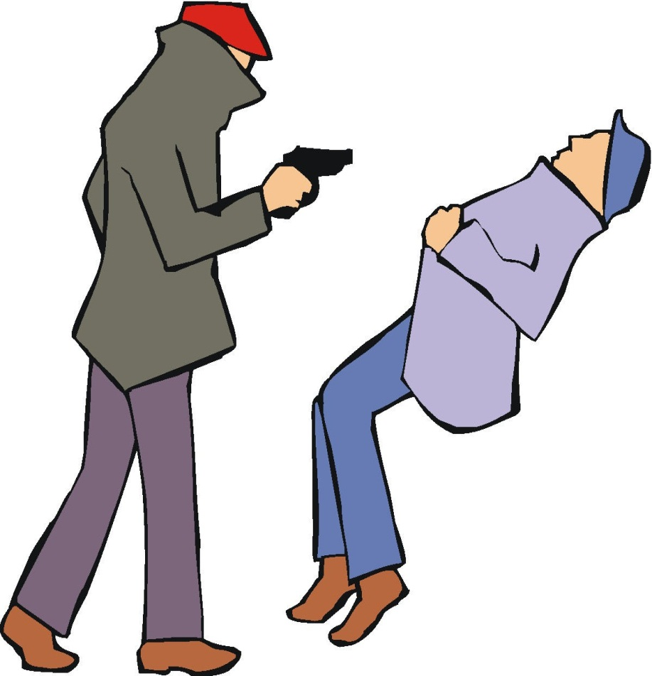
Chapter 22 Vocabulary
ἀποκτείνω
I kill

Slide 41

Chapter 22 Vocabulary
κεφαλή, -ῆς, ἡ
head

Slide 42
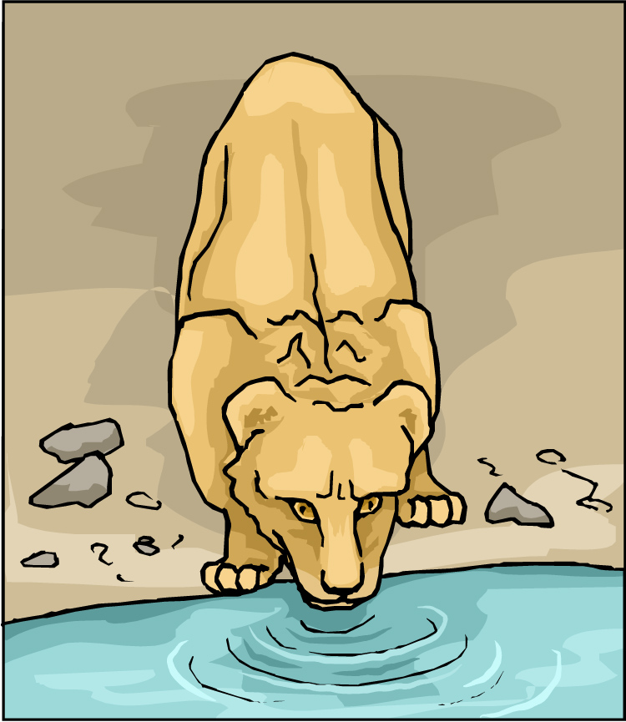
Chapter 22 Vocabulary
πίνω
I drink

Slide 43

Chapter 22 Vocabulary
πλοῖον, -ου, τό
boat

Slide 44

Chapter 22 Vocabulary
πῦρ, -ός, τό
fire

Slide 45
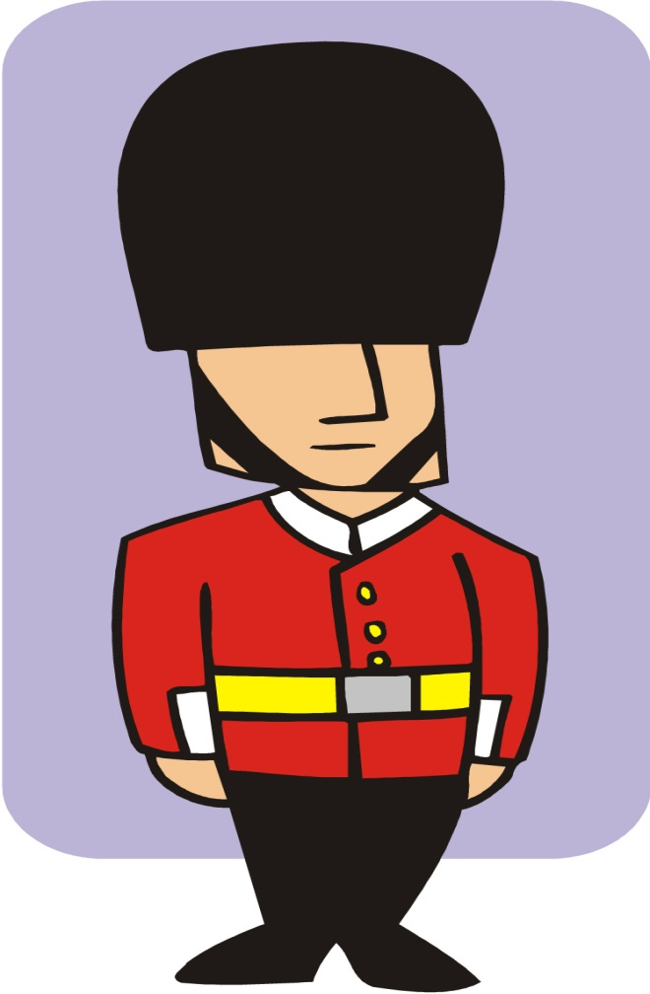
Chapter 22 Vocabulary
τηρέω
I keep, guard

Slide 46

Chapter 22 Vocabulary
ὕδωρ, -ατος, τό
water

Slide 47

Chapter 22 Vocabulary
χαίρω
I rejoice

Slide 48
Vocabulary Review

Slide 49
Chapter 21 Vocabulary
ἀνοίγω
I open
βαπτίζω
I baptize
εὐαγγέλιον, -ου, τό
gospel
μαρτυρέω
I witness
πέμπω
I send

Slide 50
Chapter 21 Vocabulary
προνηρός, -ά, -όν
evil, bad
πρόσωπον, -ου, τό
face
σημεῖον, -ου, τό
sign, miracle
στόμα, -ατος, τό
mouth
ὑπάγω
I go away

Slide 51
Chapter 20 Vocabulary
ἀναβαίνω
I go up
ἄρχω
I rule, begin (in mid.)
ἕκαστος, -η, -ον
each, every
ἐκβάλλω
I drive out
κἀγώ
and I, but I

Slide 52
Chapter 20 Vocabulary
καταβαίνω
I go down
μᾶλλον
more, rather
μήτηρ, -ός, ἡ
mother
ὅπου
where, since
ὥστε
therefore, so that

Slide 53
Chapter 19 Vocabulary
ἀκολουθέω
I follow
ἐνώπιον
before
θάλασσα, -ης, ἡ
sea, lake
κάθημαι
I sit
καιρός, -οῦ, ὁ
time

Slide 54
Chapter 19 Vocabulary
οὔτε
and not, nor, neither
πίπτω
I fall
πούς, ποδός, ὁ
foot
προσέρχομαι
I come/go to
προσεύχομαι
I pray

Slide 55
Chapter 18 Vocabulary
genna<w
I beget
dikaiosu<nh, -hj, h[
righteousness
e]a<n
if, when
ei]rh<nh, -hj, h[
peace
oi#da
I know

Slide 56
Chapter 18 Vocabulary
oi]ki<a, -aj, h[
house
o[ra<w
I see
peripate<w
I walk
pw?j
how?
fobe<omai
I fear

Slide 57
Chapter 17 Vocabulary
εἰ
if, that
ἐσθίω
I eat
ζάω
I live
ζητέω
I seek
ἤ
or, either

Slide 58
Chapter 17 Vocabulary
καλέω
I call
λαλέω
I speak, say
παρακαλέω
I urge, exhort
πληρόω
I fill, complete
ποιέω
I do, make

Slide 59
Chapter 16 Vocabulary
αἰων, -ῶνος, ὁ
Age, eternity
ἀλλήλων
one another
ἀριερεύς, -έως, ὁ
High priest
γυνή, -αικός, ἡ
woman
δύναμαι
I can, am able

Slide 60
Chapter 16 Vocabulary
ἔθνος, -ους, τό
nation
ὅσος, -η, -ον
as great as
πόλις, -εως, ἡ
city
τέ
And, and so
χείρ, χειρός, ἡ
hand

Slide 61
Chapter 15 Vocabulary
ἄλλος, -η, -ο
other
ἄρτος, -ου, ὁ
bread
δεῖ
it is necessary
ἐξουσία, -ας, ἡ
authority
ἕτερος, -α, -ον
different

Slide 62
Chapter 15 Vocabulary
ἔτι
yet, still
ὀφθαλμός, -οῦ, ὁ
eye
τέκνον, -ου, τό
child
τόπος, -ου, ὁ
place
φῶς, φωτός, τό
light

Slide 63
Chapter 14 Vocabulary
αἷμα, -ματος, τό
blood
αἴρω
I raise, take up
διδάσκω
I teach
ἴδιος, -α, -ον
one's own
καλός, -ή, -όν
good

Slide 64
Chapter 14 Vocabulary
μέλλω
I am about to, intend
ὁδός, -οῦ, ἡ
way
πολύς, πολλή, πολύ
much, many
σῶμα, -ματος, τό
body
ψυχή, -ῆς, ἡ
soul, life

Slide 65
Chapter 13 Vocabulary
ἀνήρ, ἀνδρός, ὁ
man, husband
βασιλεύς, -ἐως, ὁ
king
δύναμις, -εως, ἡ
power, miracle
ὄνομα, -ματος, τό
name
πᾶς, πᾶσα, πᾶν
each, every, all

Slide 66
Chapter 13 Vocabulary
πατήρ, πατρός, ὁ
father
πιστις, πίστεως, ἡ
faith, belief
πνεῦμα, -ατος, τό
spirit, wind
σάρξ, σαρκός, ἡ
flesh, body
χάρις, -ιτος, ἡ
grace, kindness

Slide 67
Chapter 12 Vocabulary
ἀποθνῄσκω
I die
ἐκεῖ
there
ἕως
until
ἰδού
behold

Slide 68
Chapter 12 Vocabulary
ἵνα
in order that, that
Ἰωάννης, -ου, ὁ
John
μέν
on the one hand, indeed
ὅλος, -η, -ον
whole, entire

Slide 69
Chapter 12 Vocabulary
ὅτε
when
σύν
with

Slide 70
Chapter 11 Vocabulary
ἀπέρχομαι
I go away, leave
ἐκεῖνος
that
Ἰουδαῖος, -α, -ον
Jewish
καθώς
as, just as

Slide 71
Chapter 11 Vocabulary
ὅς, ἥ, ὅ
who, which
ὅταν
when
πάλιν
again
οὗτος, αὗτη, τοῦτο
this

Slide 72
Chapter 11 Vocabulary
Πέτρος, -ου, ὁ
Peter
ὑπέρ
for, about (gen.)
above, beyond (acc.)

Slide 73
Chapter 11 Vocabulary
ὑπέρ
for, about (gen.)
above, beyond (acc.)

Slide 74
Vocabulary Ch. 10
life
ζωή, -ῆς, ἡ
death
θάνατος, -ου, ὁ
I judge
κρίνω
I remain
μένω
only, alone
μόνος, -η, -ον

Slide 75
Vocabulary Ch. 10
now
νῦν
and not, nor
οὐδέ
Paul
Παῦλος
I save
σῴζω
then
τότε

Slide 76
Vocabulary Ch. 9
I answer
ἀποκρίνομαι
I send
ἀποστέλλω
I throw
βάλλω
I become
γίνομαι
I come in
εἰσέρχομαι

Slide 77
Vocabulary Ch. 9
I go out
ἐξέρχομαι
I come/go
ἔρχομαι
I wish
θέλω
thus, so
οὕτως
I go
πορεύομαι

Slide 78
Vocabulary Ch. 8
he/she/it
αὐτός, -ή, -ό
land, earth, region
γῆ, -ῆς, ἡ
I, we
ἐγώ, ἡμεῖς
day
ἡμέρα, -ας, ἡ
that, so that
ὅτι

Slide 79
Vocabulary Ch. 8
so, then, therefore
οὖν
crowd
ὄχλος, -ου, ὁ
from
παρά (with Gen.)
beside, with
παρά (with Dat.)
alongside, beside
παρά (with Acc.)

Slide 80
Vocabulary Ch. 8
you / you (pl)
σύ / ὑμεῖς
by, at the hands of
ὑπό (with Gen.)
under, below
ὑπό (with Acc.)

Slide 81
Vocabulary -- Ch. 7
good
ἀγαθός, -ή, -όν
Holy
ἅγιος, -α, -ον
righteous
δίκαιοις, -α, -ον

Slide 82
Vocabulary – Ch. 7
I am
εἰμί
Jewish, a Jew
Ἰουδαῖος, -α, -ον
Great
μέγας, μεγάλη, μέγα

Slide 83
Vocabulary -- Ch. 7
dead
νεκρός, -ά, -όν
no, not
οὐ, οὐκ, οὐχ
first
πρῶτος, -η, -ον
voice
φωνή, -ῆς, ἡ

Slide 84
Chapter 6 Vocabulary
ἀπό (Gen.)
from
διά (Gen.)
through
διά (Acc.)
on account of
εἰς (Acc.)
into

Slide 85
Chapter 6 Vocabulary
ἐκ (Gen.)
out of, from
ἐν (Dat.)
in
ἐπί (Gen.)
on, over
ἐπί (Dat.)
on, at, against, on the basis of

Slide 86
Chapter 6 Vocabulary
ἐπί (Acc.)
on, to, toward, against
κατά (Gen.)
down, against
κατά (Acc.)
according to
μετά (Gen.)
with

Slide 87
Chapter 6 Vocabulary
μετά (Acc.)
after, behind
περί (Gen.)
about, concerning
περί (Acc.)
around, near
πρός (Acc.)
to

Slide 88
Ch. 5 -- Vocabulary
love
ἀγάπη, -ης, ἡ
truth
ἀλήθεια, -ας, ἡ
sin
ἁμαρτία, -ας, ἡ
kingdom
βασιλεία, -ας, ἡ
writing, Scripture
γραφή, -ῆς, ἡ

Slide 89
Ch. 5 -- Vocabulary
I raise up
ἐγείρω
assembly, church
ἐκκλησία, -ας, ἡ
work
ἔργον, -ου, τό
disciple
μαθητής, -οῦ, ὁ
Hour
ὥρα, -ας, ἡ

Slide 90
Ch. 4 -- Vocabulary
I love
ἀγαπάω
I write
γράφω
but, and
δέ
servant, slave
δοῦλος, -ου, ὁ
I find
εὑρίσκω

Slide 91
Ch. 4 -- Vocabulary
temple
ἱερόν, -οῦ, τό
People
λαός, -οῦ, ὁ
law
νόμος, -ου, ὁ
house
οἶκος, -ου, ὁ
as, about, how
ὡς

Slide 92
Ch. 3 -- Vocabulary
but, yet
ἀλλἀ
apostle, sent one
ἀπόστολος, -ου, ὁ
I see
βλέπω
for, then
γάρ
I know
γινώσκω

Slide 93
Ch. 3 -- Vocabulary
Jesus
Ἰησοῦς, -οῦ, ὁ
I take, receive
λαμβάνω
I loose
λύω
heaven
οὐρανός, -οῦ, ὁ
I believe
πιστεύω

Slide 94
Ch. 2 -- Vocabulary
brother
ἀδελφός, -οῦ, ὁ
I hear, obey
ἀκούω
glory, fame
δόξα, -ης, ἡ
I have
ἔχω
world
κόσμος, -ου, ὁ

Slide 95
Ch. 2 -- Vocabulary
Lord, sir
κύριος, -ου, ὁ
word
λόγος, -ου, ὁ
Peter
Πἑτρος, -ου, ὁ
son
υἱός, -οῦ, ὁ
Pharisee
Φαρισαῖος, -ου, ὁ

Slide 96
Ch. 1 -- Vocabulary
angel, messenger
ἄγγελος, -ου, ὁ
verily, truly
ἀμήν
man, humankind
ἄνθρωπος, -ου, ὁ
I
ἐγώ
God
θεός, -οῦ, ὁ

Slide 97
Ch. 1 -- Vocabulary
and, also, even
καί
heart
καρδία, -ας, ἡ
I say
λέγω
prophet
προφήτης, -ου, ὁ
Christ, Messiah
Χριστός, -οῦ, ὁ

Slide 98
In Order Vocabulary Review

Slide 99
Ch. 1 -- Vocabulary
angel, messenger
ἄγγελος, -ου, ὁ
verily, truly
ἀμήν
man, humankind
ἄνθρωπος, -ου, ὁ
I
ἐγώ
God
θεός, -οῦ, ὁ

Slide 100
Ch. 1 -- Vocabulary
and, also, even
καί
heart
καρδία, -ας, ἡ
I say
λέγω
prophet
προφήτης, -ου, ὁ
Christ, Messiah
Χριστός, -οῦ, ὁ

Slide 101
Ch. 2 -- Vocabulary
brother
ἀδελφός, -οῦ, ὁ
I hear, obey
ἀκούω
glory, fame
δόξα, -ης, ἡ
I have
ἔχω
world
κόσμος, -ου, ὁ

Slide 102
Ch. 2 -- Vocabulary
Lord, sir
κύριος, -ου, ὁ
word
λόγος, -ου, ὁ
Peter
Πἑτρος, -ου, ὁ
son
υἱός, -οῦ, ὁ
Pharisee
Φαρισαῖος, -ου, ὁ

Slide 103
Ch. 3 -- Vocabulary
but, yet
ἀλλἀ
apostle, sent one
ἀπόστολος, -ου, ὁ
I see
βλέπω
for, then
γάρ
I know
γινώσκω

Slide 104
Ch. 3 -- Vocabulary
Jesus
Ἰησοῦς, -οῦ, ὁ
I take, receive
λαμβάνω
I loose
λύω
heaven
οὐρανός, -οῦ, ὁ
I believe
πιστεύω

Slide 105
Ch. 4 -- Vocabulary
I love
ἀγαπάω
I write
γράφω
but, and
δέ
servant, slave
δοῦλος, -ου, ὁ
I find
εὑρίσκω

Slide 106
Ch. 4 -- Vocabulary
temple
ἱερόν, -οῦ, τό
People
λαός, -οῦ, ὁ
law
νόμος, -ου, ὁ
house
οἶκος, -ου, ὁ
as, about, how
ὡς

Slide 107
Ch. 5 -- Vocabulary
love
ἀγάπη, -ης, ἡ
truth
ἀλήθεια, -ας, ἡ
sin
ἁμαρτία, -ας, ἡ
kingdom
βασιλεία, -ας, ἡ
writing, Scripture
γραφή, -ῆς, ἡ

Slide 108
Ch. 5 -- Vocabulary
I raise up
ἐγείρω
assembly, church
ἐκκλησία, -ας, ἡ
work
ἔργον, -ου, τό
disciple
μαθητής, -οῦ, ὁ
Hour
ὥρα, -ας, ἡ

Slide 109
Chapter 6 Vocabulary
ἀπό (Gen.)
from
διά (Gen.)
through
διά (Acc.)
on account of
εἰς (Acc.)
into

Slide 110
Chapter 6 Vocabulary
ἐκ (Gen.)
out of, from
ἐν (Dat.)
in
ἐπί (Gen.)
on, over
ἐπί (Dat.)
on, at, against, on the basis of

Slide 111
Chapter 6 Vocabulary
ἐπί (Acc.)
on, to, toward, against
κατά (Gen.)
down, against
κατά (Acc.)
according to
μετά (Gen.)
with

Slide 112
Chapter 6 Vocabulary
μετά (Acc.)
after, behind
περί (Gen.)
about, concerning
περί (Acc.)
around, near
πρός (Acc.)
to

Slide 113
Vocabulary -- Ch. 7
good
ἀγαθός, -ή, -όν
Holy
ἅγιος, -α, -ον
righteous
δίκαιοις, -α, -ον

Slide 114
Vocabulary – Ch. 7
I am
εἰμί
Jewish, a Jew
Ἰουδαῖος, -α, -ον
Great
μέγας, μεγάλη, μέγα

Slide 115
Vocabulary -- Ch. 7
dead
νεκρός, -ά, -όν
no, not
οὐ, οὐκ, οὐχ
first
πρῶτος, -η, -ον
voice
φωνή, -ῆς, ἡ

Slide 116
Vocabulary Ch. 8
he/she/it
αὐτός, -ή, -ό
land, earth, region
γῆ, -ῆς, ἡ
I, we
ἐγώ, ἡμεῖς
day
ἡμέρα, -ας, ἡ
that, so that
ὅτι

Slide 117
Vocabulary Ch. 8
so, then, therefore
οὖν
crowd
ὄχλος, -ου, ὁ
from
παρά (with Gen.)
beside, with
παρά (with Dat.)
alongside, beside
παρά (with Acc.)

Slide 118
Vocabulary Ch. 8
you / you (pl)
σύ / ὑμεῖς
by, at the hands of
ὑπό (with Gen.)
under, below
ὑπό (with Acc.)

Slide 119
Vocabulary Ch. 9
I answer
ἀποκρίνομαι
I send
ἀποστέλλω
I throw
βάλλω
I become
γίνομαι
I come in
εἰσέρχομαι

Slide 120
Vocabulary Ch. 9
I go out
ἐξέρχομαι
I come/go
ἔρχομαι
I wish
θέλω
thus, so
οὕτως
I go
πορεύομαι

Slide 121
Vocabulary Ch. 10
life
ζωή, -ῆς, ἡ
death
θάνατος, -ου, ὁ
I judge
κρίνω
I remain
μένω
only, alone
μόνος, -η, -ον

Slide 122
Vocabulary Ch. 10
now
νῦν
and not, nor
οὐδέ
Paul
Παῦλος
I save
σῴζω
then
τότε

Slide 123
Chapter 11 Vocabulary
ἀπέρχομαι
I go away, leave
ἐκεῖνος
that
Ἰουδαῖος, -α, -ον
Jewish
καθώς
as, just as

Slide 124
Chapter 11 Vocabulary
ὅς, ἥ, ὅ
who, which
ὅταν
when
πάλιν
again
οὗτος, αὗτη, τοῦτο
this

Slide 125
Chapter 11 Vocabulary
Πέτρος, -ου, ὁ
Peter
ὑπέρ
for, about (gen.)
above, beyond (acc.)

Slide 126
Chapter 11 Vocabulary
ὑπέρ
for, about (gen.)
above, beyond (acc.)

Slide 127
Chapter 12 Vocabulary
ἀποθνῄσκω
I die
ἐκεῖ
there
ἕως
until
ἰδού
behold

Slide 128
Chapter 12 Vocabulary
ἵνα
in order that, that
Ἰωάννης, -ου, ὁ
John
μέν
on the one hand, indeed
ὅλος, -η, -ον
whole, entire

Slide 129
Chapter 12 Vocabulary
ὅτε
when
σύν
with

Slide 130
Chapter 13 Vocabulary
ἀνήρ, ἀνδρός, ὁ
man, husband
βασιλεύς, -ἐως, ὁ
king
δύναμις, -εως, ἡ
power, miracle
ὄνομα, -ματος, τό
name
πᾶς, πᾶσα, πᾶν
each, every, all

Slide 131
Chapter 13 Vocabulary
πατήρ, πατρός, ὁ
father
πιστις, πίστεως, ἡ
faith, belief
πνεῦμα, -ατος, τό
spirit, wind
σάρξ, σαρκός, ἡ
flesh, body
χάρις, -ιτος, ἡ
grace, kindness

Slide 132
Chapter 14 Vocabulary
αἷμα, -ματος, τό
blood
αἴρω
I raise, take up
διδάσκω
I teach
ἴδιος, -α, -ον
one's own
καλός, -ή, -όν
good

Slide 133
Chapter 14 Vocabulary
μέλλω
I am about to, intend
ὁδός, -οῦ, ἡ
way
πολύς, πολλή, πολύ
much, many
σῶμα, -ματος, τό
body
ψυχή, -ῆς, ἡ
soul, life

Slide 134
Chapter 15 Vocabulary
ἄλλος, -η, -ο
other
ἄρτος, -ου, ὁ
bread
δεῖ
it is necessary
ἐξουσία, -ας, ἡ
authority
ἕτερος, -α, -ον
different

Slide 135
Chapter 15 Vocabulary
ἔτι
yet, still
ὀφθαλμός, -οῦ, ὁ
eye
τέκνον, -ου, τό
child
τόπος, -ου, ὁ
place
φῶς, φωτός, τό
light

Slide 136
Chapter 16 Vocabulary
αἰων, -ῶνος, ὁ
Age, eternity
ἀλλήλων
one another
ἀρχιερεύς, -έως, ὁ
High priest
γυνή, -αικός, ἡ
woman
δύναμαι
I can, am able

Slide 137
Chapter 16 Vocabulary
ἔθνος, -ους, τό
nation
ὅσος, -η, -ον
as great as
πόλις, -εως, ἡ
city
τέ
And, and so
χείρ, χειρός, ἡ
hand

Slide 138
Chapter 17 Vocabulary
εἰ
if, that
ἐσθίω
I eat
ζάω
I live
ζητέω
I seek
ἤ
or, either

Slide 139
Chapter 17 Vocabulary
καλέω
I call
λαλέω
I speak, say
παρακαλέω
I urge, exhort
πληρόω
I fill, complete
ποιέω
I do, make

Slide 140
Chapter 18 Vocabulary
genna<w
I beget
dikaiosu<nh, -hj, h[
righteousness
e]a<n
if, when
ei]rh<nh, -hj, h[
peace
oi#da
I know

Slide 141
Chapter 18 Vocabulary
oi]ki<a, -aj, h[
house
o[ra<w
I see
peripate<w
I walk
pw?j
how?
fobe<omai
I fear

Slide 142
Chapter 19 Vocabulary
ἀκολουθέω
I follow
ἐνώπιον
before
θάλασσα, -ης, ἡ
sea, lake
κάθημαι
I sit
καιρός, -οῦ, ὁ
time

Slide 143
Chapter 19 Vocabulary
οὔτε
and not, nor, neither
πίπτω
I fall
πούς, ποδός, ὁ
foot
προσέρχομαι
I come/go to
προσεύχομαι
I pray

